Slide 1
Group: Developers Geek
Project Name: Blood Bank Management System

Slide 2
Group Member
Shakil Ahmed
ID: 17182103010
Arifur Rahman Kawser
ID: 17182103012
Momin Ali
ID: 17182103011

Slide 3
Introduction
Blood Bank Management System (BBMS) is a Application system that can assists the information of blood bag during its handling in the blood bank. With this system, the user of this system can key in the result of blood test that has been conducted to each of the blood bag received by the blood bank.

Slide 4
Purpose of the Application
The main objective of the Blood Bank Management System is to manage the details of Blood ,Donor, Blood Group, Blood Bank, Stock and Location of Hospitals. It manages all the information about Blood , Blood Cell, Stock , Donor, Looking-for blood . The project is totally built at administrative end and thus only the administrator & users are guaranteed the access.

Slide 5
Tools Used
Firebase Database
Firebase Authentication
Google Maps API
Android Studio IDE
Android version 4.0 or later
Android SDK 17-28

Slide 6
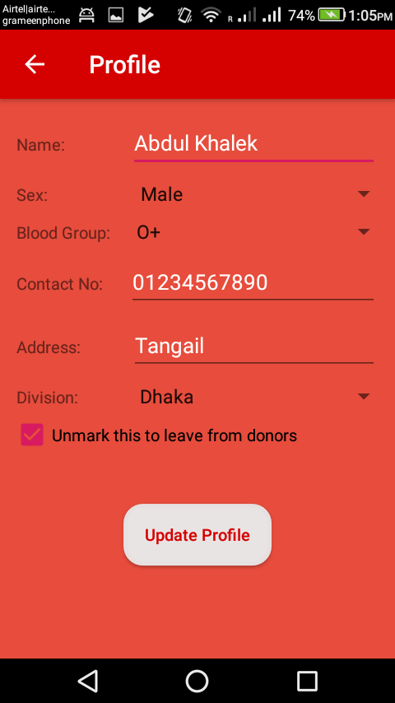
Features of this App with interface
Creating profile for users: Registration with name, blood group, contact number and other information.

Slide 7
Features of this App with interface
Donor management-donor registration, managing donor database, recording their physical and medical statistics.

Slide 8
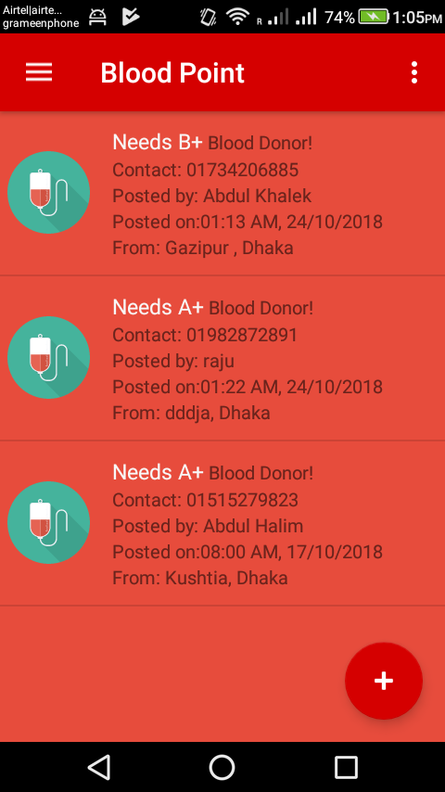
Features of this App with interface
List of requested blood group for patient.

Slide 9
Features of this App with interface
Showing requested list of blood donor for all blood group among all over the country.

Slide 10
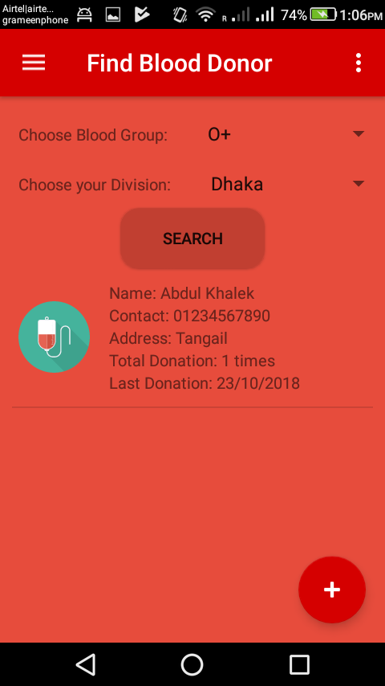
Features of this App with interface
Query donor by blood group & division.

Slide 11
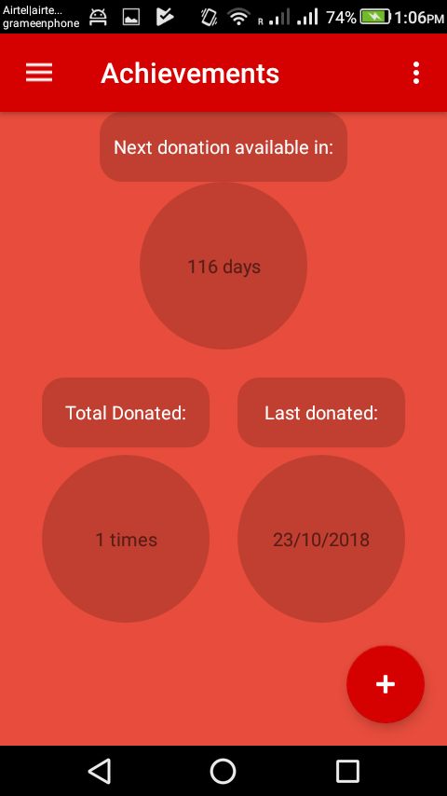
Features of this App with interface
There is a database table named “Achievement” : where a donor can count next donation date, Total Donation also last donation date.

Slide 12
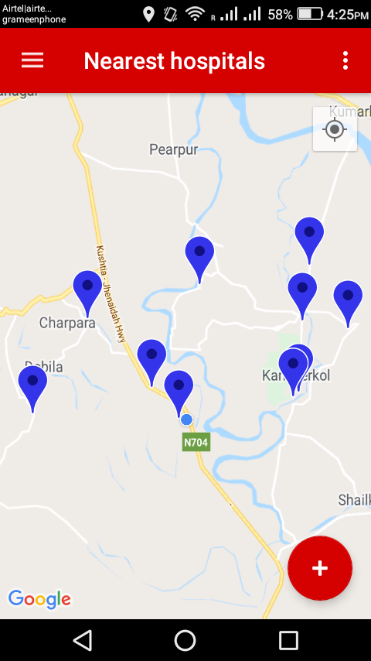
Features of this App with interface
An interested Donor can donate blood without blood request. For this the donor have to use “The Nearest Hospital” Module.
In this module Donor can find the nearest hospitals from his/her current location.

Slide 13
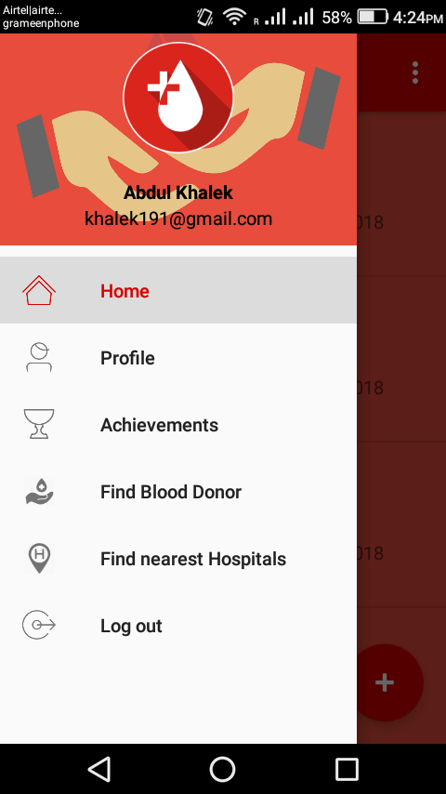
Features of this App with interface
In is App, There is a navigation button where user can easily shift one module to another module and also can logout for closing the app.

Slide 14
Future Implementation
Add chat option for donor and user.
Create a website based on this apps.
Realtime location direction of patient to donor.
Health checkup information update of donor.

Slide 15
Conclusion
In this project We tried to implement the Centralized Blood Bank Management System. This project is built on salesforce and can serve many advantages to the Users. This software is efficient in maintaining donor's details and can easily perform operations on blood donation's records. This software also reduces the work load of the blood bank management to know how much blood is available and also keep the records of how many time a donor donates blood by this application.

Slide 16
Thank You

